Slide 1

CMR COLLEGE OF ENGINEERING & TECHNOLOGY
Kandlakoya, Medchal, Hyderabad - 501401
Department of Computer Science and Engineering
Integrated traffic monitoring system using YOLO for Speed Estimation and Vehicle Counting
Name of the student:
20H51A0504 - A. Nithin kumar reddy
20H51A0531 - Balaji Bhandare
20H51A0592 - Gangula Sindhu
Under esteemed guidance of
Ms. A. Mounika Rajeswari
(Assistant Professor)

Slide 2
Outline
Abstract
Introduction
Literature survey
Existing system
- Problems in existing system
Research Objective of Presentation
Problem Definition
Research work
- Proposed system architecture
- Methods
- Comparison of Proposed system with an existing system
Performance Measure
Results
Conclusion
Future Work
References
Notes:
2

Slide 3
Abstract
Notes:
3

Slide 4
Abstract
Modern urban environments face complex challenges in traffic management and safety. The primary aim of this project is to develop an intelligent and efficient traffic monitoring system capable of enhancing road safety, enforcing traffic regulations, and providing valuable insights for traffic management authorities. This project introduces a comprehensive traffic monitoring and management system that leverages the YOLO (You Only Look Once) object detection algorithm. The system addresses critical aspects of traffic control including speed estimation and vehicle counting within a single integrated pipeline.
Speed estimation, a cornerstone of traffic monitoring, is executed using deep sort algorithm and tracking techniques empowered by YOLO. The system calculates vehicle speeds in real time, aiding in the identification of speed violations and the optimization of traffic flow. Real-time vehicle counting using YOLO is seamlessly integrated into the pipeline. The vehicle counts include incoming and outgoing provide valuable insights for traffic authorities, aiding in informed decisions about road capacity and congestion management.

Slide 5
Introduction
Notes:
5

Slide 6
Introduction
The management of traffic and ensuring road safety has evolved into a multifaceted challenge. This project introduces a comprehensive traffic monitoring and management system that leverages the YOLO (You Only Look Once) object detection algorithm.
The system addresses critical aspects of traffic control including speed estimation and vehicle counting within a single integrated pipeline.
Speed estimation refers to the process of calculating the velocity of vehicles in real-time as they traverse a monitored area and is executed using deep sort algorithm and tracking techniques empowered by YOLO.
Real-time vehicle counting using YOLO is seamlessly integrated into the pipeline. The vehicle counts include incoming and outgoing provide valuable insights for traffic authorities
The system integration enables a comprehensive view of traffic conditions, allowing for better-informed decision-making by traffic management authorities.
Notes:
6

Slide 7
Literature Survey

Slide 8
Existing System
Vehicle Counting and Traffic Congestion Detection Using Yolov3
The work is carried out to detect and classify the vehicles using the OpenCV module from Python which performs image processing and the pre-trained yolov3 algorithm which performs the detection and classification of vehicles on the images and videos.
And later based upon the number of vehicles detected we predict the traffic congestion.
Vehicle speed detection using image processing
A radar technology was used to determine the speed on highways. But it has a disadvantage of high cost.
A lidar detector was designed to detect the infrared emissions of law enforcement agencies lidar speed detection devices and warn motorists that their speed is being measured.

Slide 9
Problems in Existing System
Accuracy and Precision: YOLO may not always achieve high accuracy and precision in vehicle counting, especially in challenging conditions such as low light, bad weather, or complex traffic scenarios.
Vehicle Occlusion: When vehicles overlap or partially obstruct each other, it can be challenging for YOLO to accurately detect and count them.
Size and Scale Variation: Vehicles come in various sizes, from motorcycles to trucks, and this size variation can pose challenges for object detection algorithms
Image Quality: Ensuring consistent image quality in varying weather conditions and lighting is challenging, as poor-quality images can impact accuracy.
Real-Time Processing: Processing images in real time can be resource-demanding, and delays in processing can affect the system's responsiveness to speed violations.

Slide 10
Research Objective
Notes:
10

Slide 11
Research objective
Development of an Intelligent Traffic Monitoring System: The main research objective is to design, develop, and implement an intelligent traffic monitoring system that integrates YOLO object detection for real-time traffic management and safety enhancement.
Real-time Speed Estimation: Develop algorithms and techniques to accurately estimate the speed of vehicles in real-time as they traverse monitored areas, with a focus on identifying and addressing speed violations.
Real-time Vehicle Counting: Create a system capable of real-time vehicle counting using YOLO, counting both incoming and outgoing vehicles, to provide essential data for traffic flow management and congestion reduction.
Seamless Data Integration: Develop mechanisms for the seamless integration of data from various sources, such as cameras and other data streams, to provide a unified and comprehensive view of traffic conditions.

Slide 12
Problem Definition
Notes:
12

Slide 13
Problem Definition
The management of traffic and ensuring road safety has evolved into a multifaceted challenge which include a high frequency of traffic accidents, widespread speed violations, recurring congestion, and a pressing need for data-driven insights in traffic management.
The fundamental problem at the heart of this project lies in the limitations of existing traffic monitoring and management systems.
The project's primary challenge is to overcome the limitations of existing traffic monitoring and management systems.
The project aims to develop a system that enhances road safety, reduces congestion, minimizes accidents, and empowers traffic management authorities with the tools they need to make informed decisions.
By addressing this problem, the project strives to create urban environments where transportation is not only safer and more efficient but also contributes to an improved quality of life for residents and commuters alike.

Slide 14
Research Work
Notes:
14

Slide 15
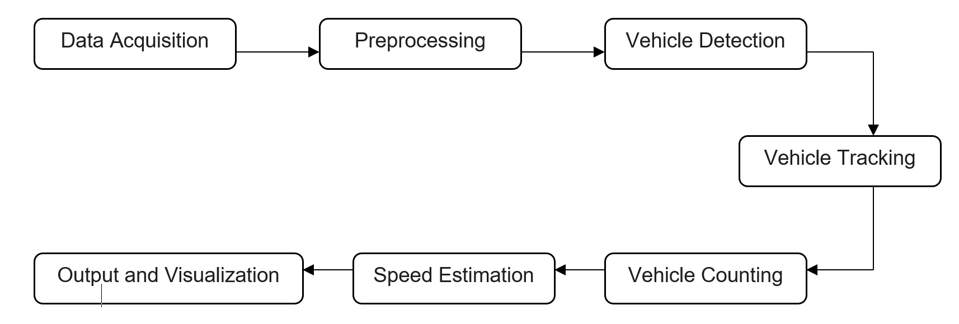
Proposed System Architecture

Slide 16
Methods
The implementation of the project is:
1)Data Acquisition and Preprocessing:
Extract individual frames from the video stream at a suitable frame rate.
Consider preprocessing techniques (e.g., resizing, normalization) for compatibility with the model.
2)Vehicle Detection:
Load a pre-trained YOLOv8 model, optimized for vehicle detection.
Pass each frame through the model to obtain bounding boxes and class labels.
Implement non-maximum suppression to eliminate redundant detections.
3)Vehicle Tracking:
Employ the Deep SORT algorithm for robust feature tracking.
Track key points within the detected bounding boxes across consecutive frames.
Estimate vehicle trajectories based on motion vectors.

Slide 17
4)Vehicle Counting:
Define a virtual counting line across the traffic lane.
Increment a counter whenever a vehicle's trajectory crosses the counting line.
Implement separate counters for each direction of traffic.
5)Speed Estimation:
Calculate the distance travelled by a vehicle between frames using its bounding box coordinates and known camera parameters.
The distance travelled by vehicle is calculated using Euclidean distance formula.
Determine the time interval between frames based on the video frame rate.
Estimate speed using the formula: Speed = Distance / Time Interval.
6)Output and Visualization:
Display the real-time vehicle count and estimated speeds on the screen.
Overlay bounding boxes, trajectories, and speed information on the video stream for visual confirmation.

Slide 18
Comparison of Proposed System with an existing system
Features | Proposed system | Existing system
Speed | Excellent | Good
Simplicity | More simple and efficient | Relatively complex
Resource Efficiency | Higher | Lower
Accuracy | Generally higher | Good
Multiple scales | Yes | Yes
Network Architecture | Focuses on streamlining architecture for efficiency | Complex Convolutional Neural Network
Scalability | Easier to scale | Can be scaled to different resolutions
Complexity | Less complex and easy to train and deploy | More complex

Slide 19
Performance Measure
The accuracy of the model is 94.8%.
The precision achieved by the model is 94.8%.
The recall of the model is 100%.
The F1 score of the model is 97.3%.
Notes:
19

Slide 20
Results
The result of the project is:
Accurate Vehicle Counting: The integration of YOLO for detection and deep sort algorithm for tracking could lead to highly accurate vehicle counts, minimizing error rates compared to traditional methods.
Reliable Speed Estimation: Speed estimations derived from distance and time calculations combined with robust tracking should offer reliable values, valuable for traffic analysis and potential enforcement applications.
Real-time Data Acquisition: The system's ability to process video streams in real-time provides timely insights into traffic patterns and enables immediate responsiveness to changing conditions.
Visualized Insights: Overlaying tracking information and speed measurements on the video stream offers valuable visual feedback for operators and researchers to observe traffic flow dynamics and individual vehicle behavior.
Data-driven Analysis: Collected data can be further analyzed to identify peak traffic times, understand individual vehicle behavior, and inform traffic flow optimization strategies.

Slide 21
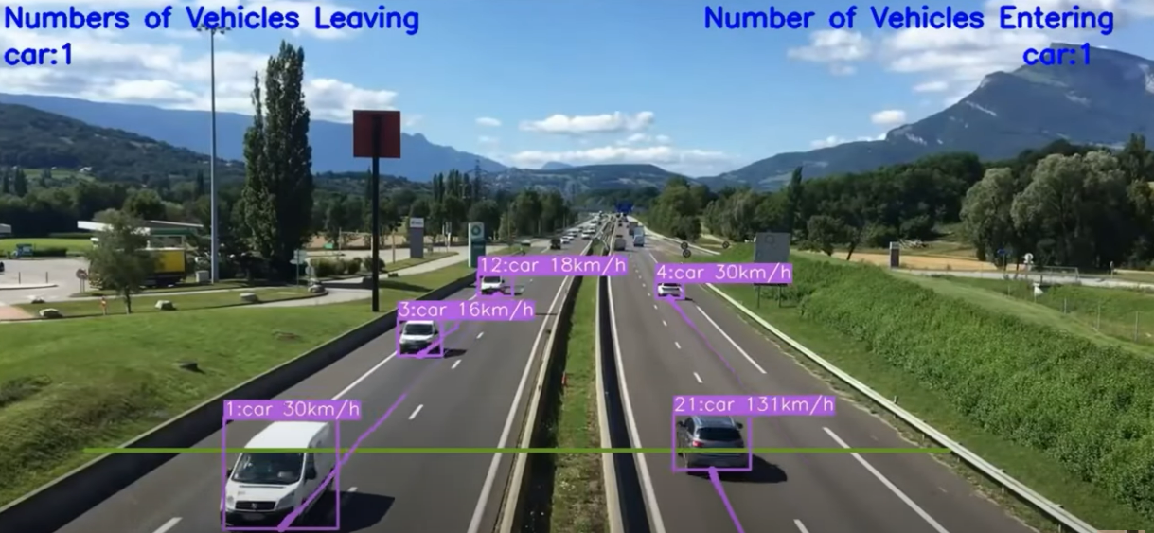

Slide 22
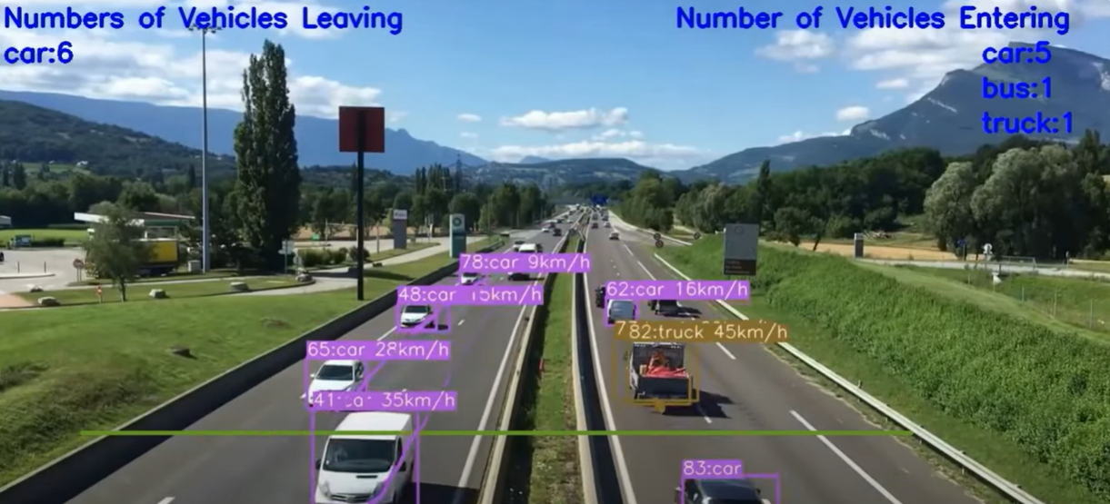

Slide 23
Conclusion
This project explored the integration of YOLO object detection and deep SORT algorithms for vehicle counting and speed estimation in traffic.
The potential benefits include highly accurate vehicle count data, reliable speed estimation, and valuable visual insights into traffic flow.
Integration with existing systems and further data analysis offer exciting possibilities for traffic management and research.
Overall, this project lays the foundation for a powerful tool in traffic monitoring and analysis, highlighting the potential of AI-powered solutions for smarter and safer transportation systems.

Slide 24
Future Work
Improved Accuracy and Robustness: Developing more accurate and robust vehicle detection models, possibly through the integration of advanced deep learning architectures, attention mechanisms, or ensemble methods.
Small Object Detection: Enhancing the capability of detection models to accurately detect small vehicles or vehicles at a distance.
Adaptation to Dynamic Environments: Designing systems capable of adapting to dynamic environments with changing traffic patterns, road conditions, and environmental factors.
Deployment in Autonomous Vehicles: Investigating the integration of vehicle detection, counting, and speed estimation algorithms into autonomous vehicle systems.
Behavior Analysis: Going beyond simple counting and speed estimation to analyze complex vehicle behaviors, such as lane-changing, merging, turning, and interactions with other road users for accident prevention.

Slide 25
References
Ammar Awni Abbass University of Baghdad "Estimating vehicle speed using image processing", AL-Mansour Journal / No.14/ Special Issue /( Part Two) 2010
Osman Ibrahim, Hazem ElGendy, and Ahmed M. ElShafee, Member, IEEE " Speed Detection Camera System using Image Processing Techniques on Video Streams ", International Journal of Computer and Electrical Engineering, Vol. 3, No. 6, December 2011
Siddharth Jhumat," Vehicle Speed Estimation in Accident Prone Areas using Image Processing ", International Journal of Advanced Research in Computer and Communication Engineering Vol. 3, Issue 5, May 2014
https://ijrpr.com/uploads/V4ISSUE5/IJRPR12846.pdf

Slide 26
Thank You!

